Slide 1
Keyword Driven Framework - Introduction

Slide 2
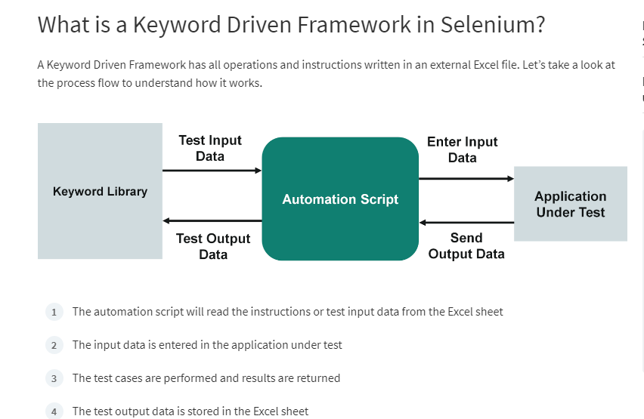

Slide 3
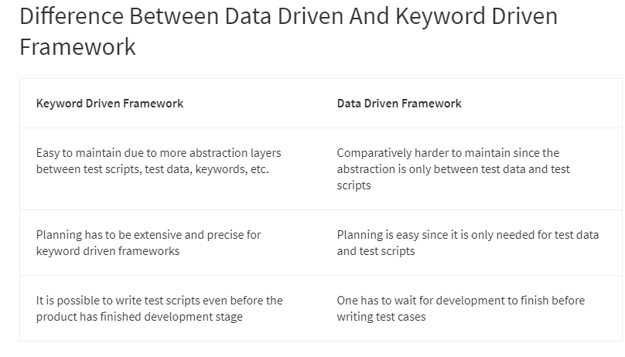

Slide 4
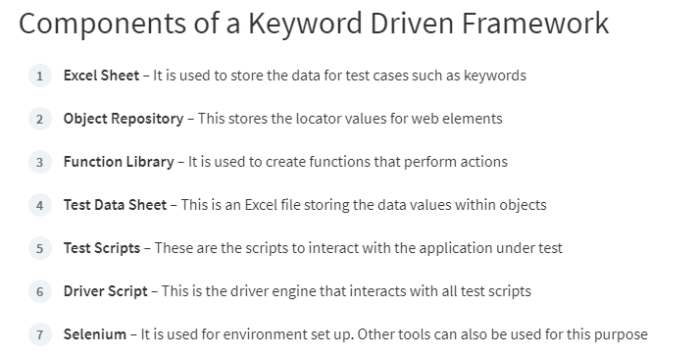

Slide 5
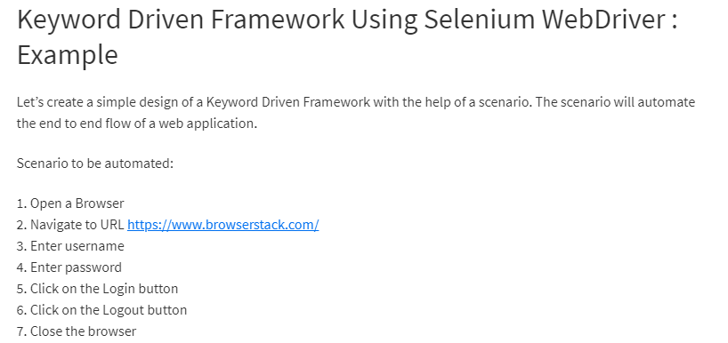

Slide 6
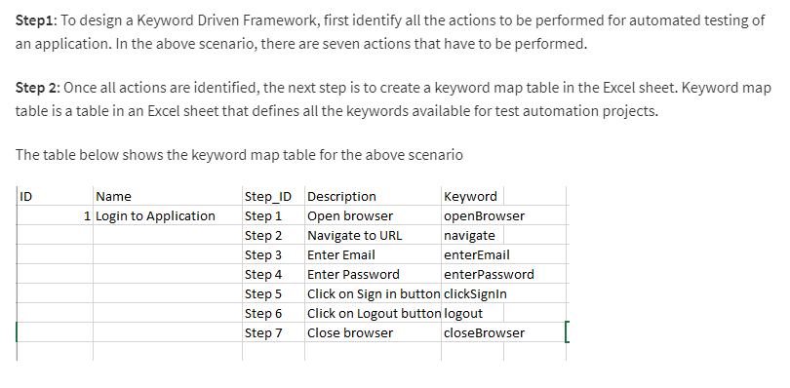

Slide 7
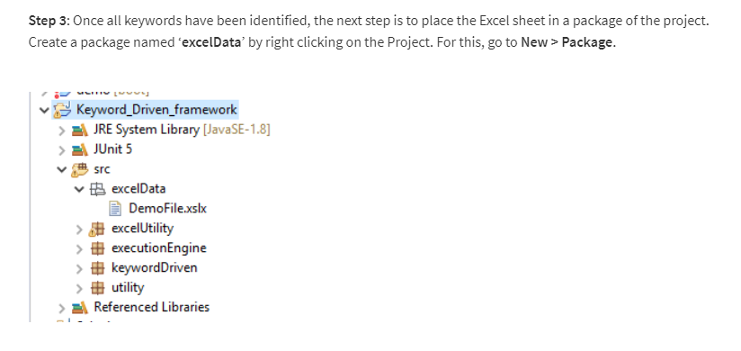

Slide 8
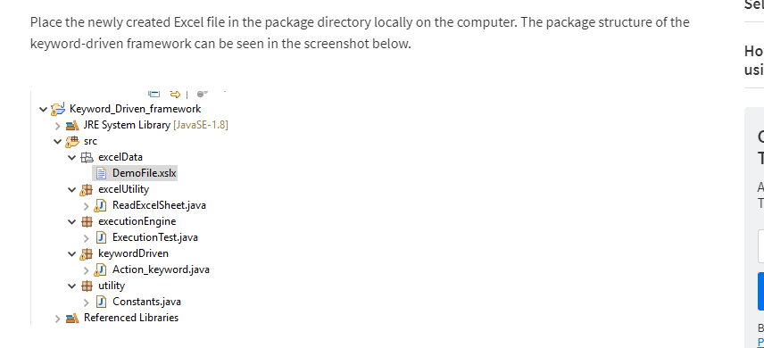

Slide 9
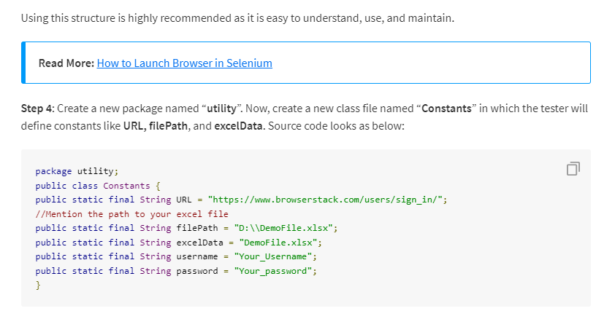

Slide 10
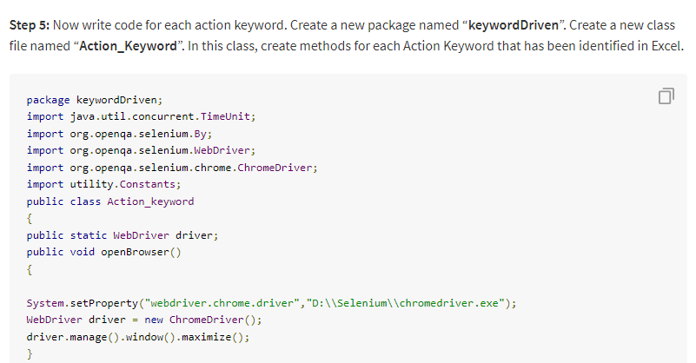

Slide 11
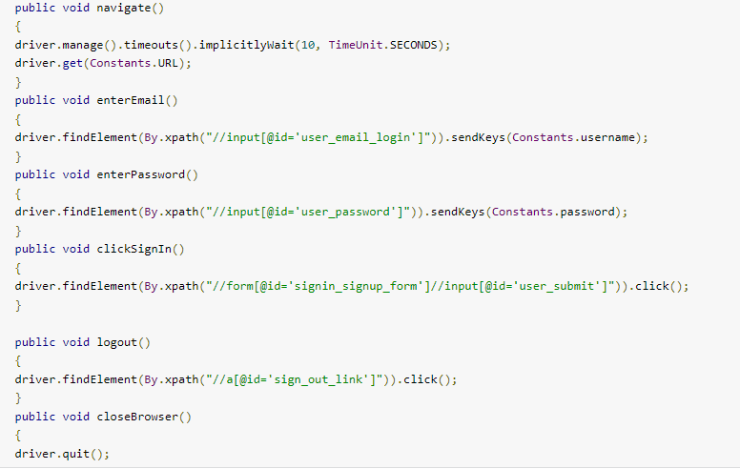

Slide 12
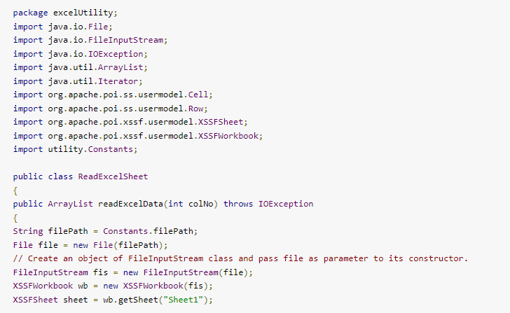
Create a new package named “excelUtility” and then create a new class file named “ReadExcelSheet”. Look at the following source code to read all keywords from the step table.

Slide 13
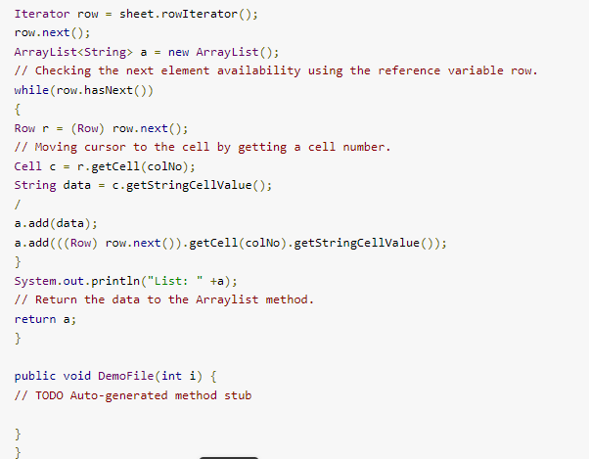
Step 7: Next step is to write code for calling readExcelData() method of ReadExcelSheet class and methods of ActionKeywords class. Create a new package named “executionEngine” and write the following source code by creating a class named “ExecutionTest”.

Slide 14
